Slide 1
All-atom protein sequence generation
Within a discrete diffusion setting
Notes:
Well to get started what motivates us to do this

Slide 2
Motivation
Notes:
Let us start simple and begin with what are proteins

Slide 3

What are proteins
Large macromolecules
Long chains from 10s – 1000s of amino acids
Function from structuring cell to aiding immune system
Sequence => Structure => Function
Notes:
So okay that is nice but why do we need to generate or design these

Slide 4
Why protein design
Proteins are a ubiquitous tool for life
Search space is vast
Computational method accelerate
Generative models help with design
Notes:
Proteins come in many shapes and forms and can be expressed as structure or sequences

Slide 5

Why sequence design?
Function is derived from structure
(Inverse) folding
Scarcity of high-quality structural data
Notes:
Now that we have established why we wanted to do this, why do we want discrete diffusion?

Slide 6

Why discrete diffusion for sequence modelling?
Has seen large success across various fields
Outputs are faster and diverse
Discrete diffusion allows for parallel generation
More token-level control
Inpainting allows to complete uncomplete sequences
Notes:
Maybe we can quickly talk about diffusion types, continuous and discrete

Slide 7

Continuous Diffusion
Diffusion models continuous distributions
Sequence is discrete
Notes:
Luckily research has already focused on how we can apply diffusion in a discrete setting

Slide 8
Discrete diffusion types
Categorical noise
Stays true to discrete setting
Reparameterization of model
Embedding noise
Embeds to continuous space
Loss trough embeddings
Classifier-based guidance
Only gradient-based guidance
Applies masking
Noise onto embeddings
Notes:
Hopefully you now share my motivation on why this approach is necessary
Let’s see what has already been done

Slide 9
Related work
Notes:
Let us first start with how sequence generation has been done in a diffusion setting

Slide 10
Protein sequence generation using diffusion
Sequence generation using embedding diffusion
Ni et al (2023)
NOS - sequence generation with categorical noise
Gruver et al (2023)
Inverse folding – sequence based on structure
Yi et al (2023)
Structure then sequence
Anand and Achim (2022)
Co-creation of structure and sequence
Martinkus et al (2023) and Luo et al (2023)
Notes:
How are protein sequence generated in a language setting

Slide 11
Protein sequence generation using Language Models
ProtGPT, DARK and Atom-by-atom
Ferruz and Hocker (2022), Moffat et al (2022) and Shepherd et al (2023)
Ligand translation and ProstT5
Grechishnikova (2021) and Heinzinger et al (2023)
Notes:
What are some approaches which use the categorical noising technique

Slide 12
Categorical Discrete Diffusion Processes
Multinomial diffusion
Hoogenboom et al (2021)
Discrete Denoising Diffusion Probabilistic Model (D3PM)
Austin et al (2021)
Unconditional text generation with DiffusionBERT
He et al (2022)
NOS guided discrete sequence generation
Gruver et al (2023)
Inverse folding
Yi et al (2023)
Notes:
How is this all-atom approach used for the design of molecules?

Slide 13
All-atom representation
Used in most micromolecule research
Krenn et al (2022) and Cheng et al (2021)
First tried in proteins using GPT-architecture
Shepherd et al (2023)
Protein into binding all-atom ligand
Grechishnikova (2021)
Notes:
We have seen what makes protein design interesting and how it has been done before
let’s look at how my research will look like

Slide 14
Research proposal
Notes:
To start of we begin with the research question

Slide 15
How does the integration of the all-atom representation in a discrete diffusion model concerns the generation of de novo protein sequences?
A two-fold approach
Notes:
What is this two-fold approach exactly?

Slide 16
Comparative experiments on different representations
Exploratory experiments with all-atom representation
Notes:
Which representations do we want to compare

Slide 17
Representations
SELFIES string
[C][=C][C][=C][C][=C][Ring1][Branch1_2]…..
Functional groups
[Aliphatic][Aromatic][Hydroxyl][Carboxyl][Amine]…..
Amino acid string
MGAQVSSQVMG…..
Amino acid motifs
[MG][A][QV][S][S][QV][MG]…..
Notes:
With that out of the way we can move onto the actual experiments

Slide 18
Experimental setup
Notes:
What are the actual experiments

Slide 19
Comparative Experiments
Exploratory Experiments
Lengths
Lengths
Data Augmentation
Lengths
Subsets of different lengths
Model #1
Model #1
All-atom D3PM
Model #1
D3PMs trained on different representations
Inpainting on 80% complete proteins
Unnatural amino acids
Notes:
But why do we want to do these experiments?

Slide 20
Why these experiments?
Subset of different lengths
- Scalability of model
Inpainting
- Generalize or novel creations
- Real world applications
Data augmentation
- Lack of expensive data
- Large models are data hungry
Unnatural amino acids
- Larger and more expressive
Notes:
How are we going to evaluate these experiments

Slide 21
Performance metrics
Subset of different lengths
- Sequence validation
- Uniqueness and novelty
- SCOP classification
- Structure validation
Inpainting
- Sequence validation
- Uniqueness and novelty
- Truthfulness
Data augmentation
- Sequence validation
Unnatural amino acids
- Training distribution vs. generated distribution
- Uniqueness and novelty
- Structure validation
Notes:
No experiment is complete without a hypothesis so what do I think will be the resulst

Slide 22
Hypotheses
Subset of different lengths
High-level representation is slightly worse than low-level
Inpainting
High-level are more diverse while low-level are generalists
Data augmentation
Positive effect in performance
Unnatural amino acids
Capture fine-tune dataset
Notes:
Maybe let’s see how a pipeline of one of such experiments will look like

Slide 23
Pipeline
UniRef50
Representation Translation
D3PMs
Representation Translation
Sequence Validation
AF2 Structure Validation
D3PMs
D3PMs
D3PMs
Notes:
Okay what and how is the representation translation module

Slide 24
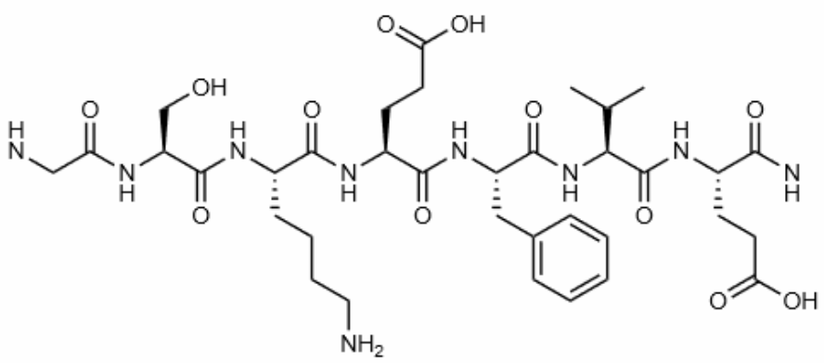
Representations
Representation Translation
SELFIES string
[C][=C][C][=C][C][=C][Ring1][Branch1_2]…..
Functional groups
[Aliphatic][Aromatic][Hydroxyl][Carboxyl][Amine]…..
Amino acid string
MGAQVSSQVMG…..
Amino acid motifs
[MG][A][QV][S][S][QV][MG]…..
Notes:
How are we going to create these sequences

Slide 25
Representations
Representation Translation
SELFIES string
RDKit and SELFIES Python library
Functional groups
RDKit Python library
Amino acid string
Original data
Amino acid motifs
Byte Pair Encoding (BPE) tokenization
Notes:
Okay but for the exploratory experiments I mentioned data augmentation

Slide 26
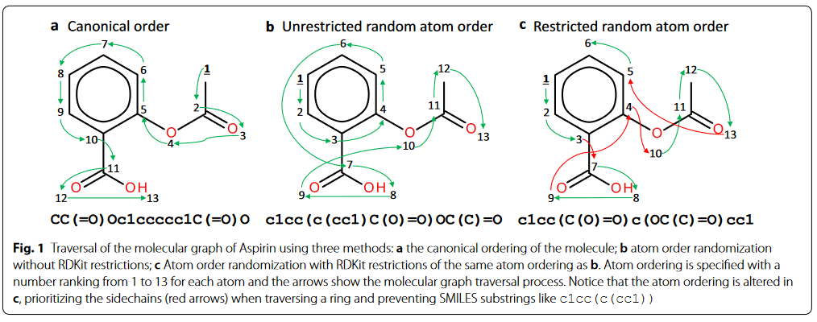
Data Augmentation
Notes:
And how do we want to create the unnatural amino acids?

Slide 27
Unnatural amino acids
Create
Create a synthetic dataset by attaching small fragments to residues
Fine-tune on
Fine-tune all-atom model on synthetic dataset
Compare
Compare training sequences with generated sequences
Notes:
Now that we have established our experiments what are we going to use to perform these experiments

Slide 28
D3PM
Discrete Denoising Diffusion Probabilistic Model
Notes:
How does a diffusion model work simply

Slide 29

Diffusion Model
Diffusion models learns complex data distribution
Forward process adds noise
Backwards process removes noise
Novel generation
Notes:
How does the math work on this?

Slide 30
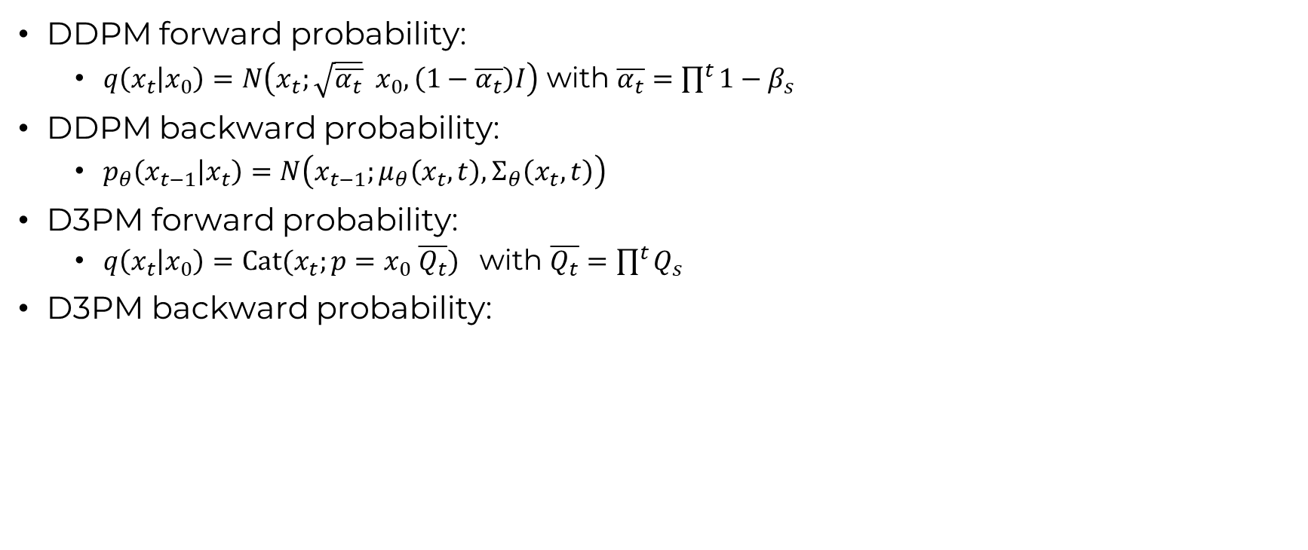
Diffusion Model
DDPM forward probability:
$q\left(x_{t} | x_{0}\right)=N\left(x_{t};\sqrt{\overline{α_{t}}}{ x}_{0},\left(1−\overline{α_{t}}\right)I\right)$ with $\overline{α_{t}}=\prod^{t}{1−β_{s}}$
DDPM backward probability:
$p_{θ}\left(x_{t−1} | x_{t}\right)=N\left(x_{t−1};μ_{θ}\left(x_{t},t\right), Σ_{θ}\left(x_{t},t\right)\right)$
D3PM forward probability:
$q\left(x_{t} | x_{0}\right)=Cat(x_{t};p=x_{0} \overline{Q_{t}})$ with $\overline{Q_{t}}=\prod^{t}{Q_{s}}$
D3PM backward probability:
Notes:
How does the D3PM process look like graphically

Slide 31
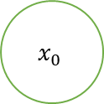

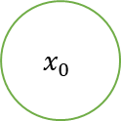
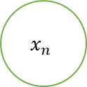


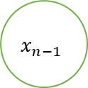
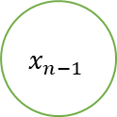
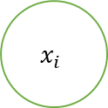

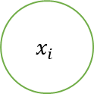



Discrete Diffusion process using masking corruption
Forward Process
Backwards Process
$$x_{0}$$
$$x_{0}$$
$$[MASK]$$
$$x_{0}$$
$$x_{0}$$
$$x_{1}$$
$$[MASK]$$
$$[MASK]$$
$$[MASK]$$
$$x_{1}$$
$$x_{i}$$
$$x_{i}$$
$$[MASK]$$
Transformer
$$x_{i}$$
Transformer
$$x_{i}$$
$$x_{n−1}$$
$$x_{n−1}$$
$$[MASK]$$
$$x_{n−1}$$
$$x_{n−1}$$
$$x_{n}$$
$$[MASK]$$
$$[MASK]$$
$$[MASK]$$
$$x_{n}$$
$$t_{0}$$
$$t_{i}$$
$$t_{N}$$
$$t_{i}$$
$$t_{0}$$
Notes:
And how does this architecture look like?

Slide 32

D3PM
$$X_{T}$$
$$X_{0}$$
$$t$$
Timestep embedding
Architecture specifics
12 layers
60 million parameters
T5-small
Notes:
Now this all needs to be implemented – how is that going

Slide 33

Implementation
Base model uses original code implementation
Ran into dependency issues
Translation Representation module
Only BPE implementation left
Data augmentation module
Complete
Synthetic unnatural dataset
Not started
Notes:
Now what data are we going to use to train this model

Slide 34
UniRef50
Notes:
What are some of the specifics of this dataset

Slide 35
UniRef50
~ 25 GB of FASTA data
~ 11M entries
Subset of UniProt’s by grouping protein sequences
Limited to sequences of max 300 length
80/10/10
Notes:
How does this apply with our different representations

Slide 36
UniRef50 in different representations
SELFIES
Vocab: 30
Mean length: ~2070
Functional groups
Vocab: 19
Mean length: ~250
Amino acids
Vocab: 20
Mean length: ~156
Notes:
How are the coming weeks looking

Slide 37
Planning
Notes:
We can look at a simple diagram first

Slide 38
What is next?
Base Model
First 2 weeks
Protein Model
3 weeks of configuring
Training
2 weeks of training all models
Testing
4 weeks of conducting experiments
Greenlight
1 Buffer week
Notes:
If you want we can discuss my full planning or we can go to the questions

Slide 39
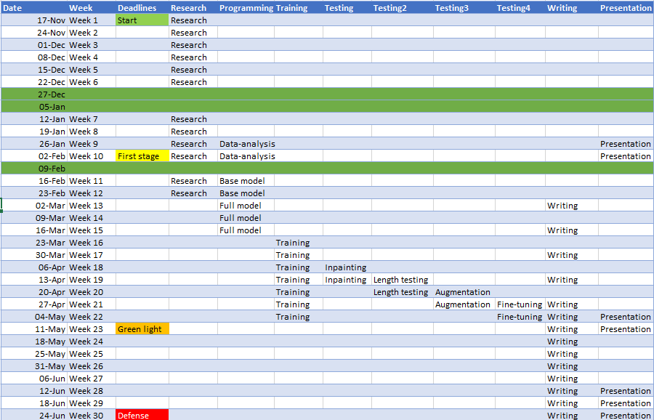

Slide 40
Questions?
And feedback

